Slide 1
Fisheries Oceanography – remote sensing methods

Slide 2
Needed software:
R https://cran.r-project.org/
R Studio https://www.rstudio.com/
# required libraries
require(ncdf4)
require(raster)
require(maps)
require(marmap)
require(chron)
require(maptools)
require(Kendall)

Slide 3
Retrieve data from the web
Read Network Common Data Form (NetCDF) files of
Chlorophyll concentration data
Convert to raster
Correct orientation and geo-reference
Save raster objects and PDF maps
Extract point data using two methods
Extract data using a shape
Look for seasonal trends
Compare bloom time series
Extract area estimates given chlorophyll conditions

Slide 4
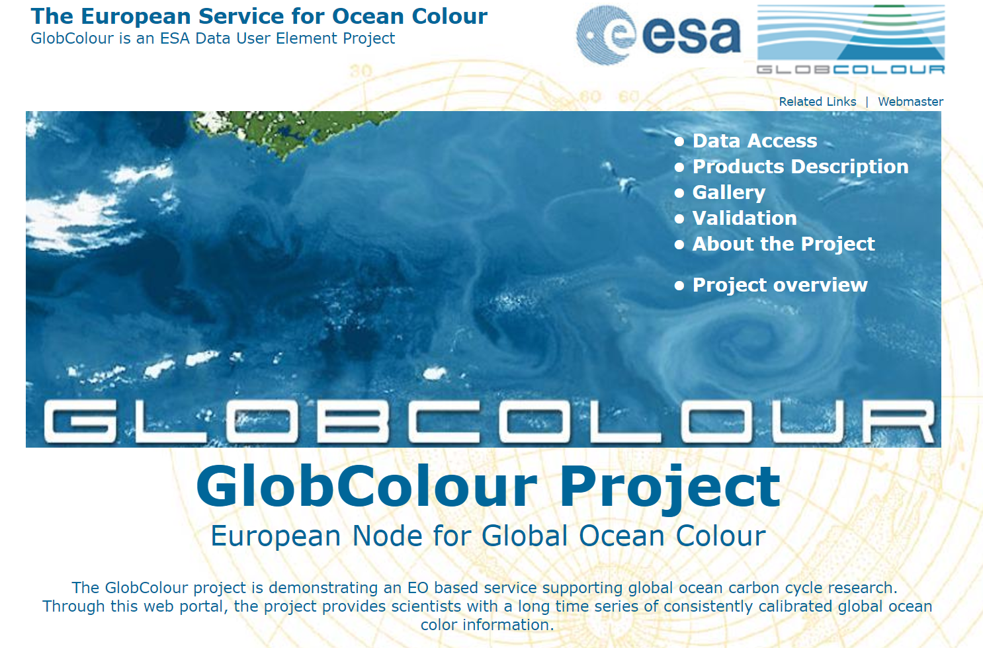
http://www.globcolour.info/

Slide 5
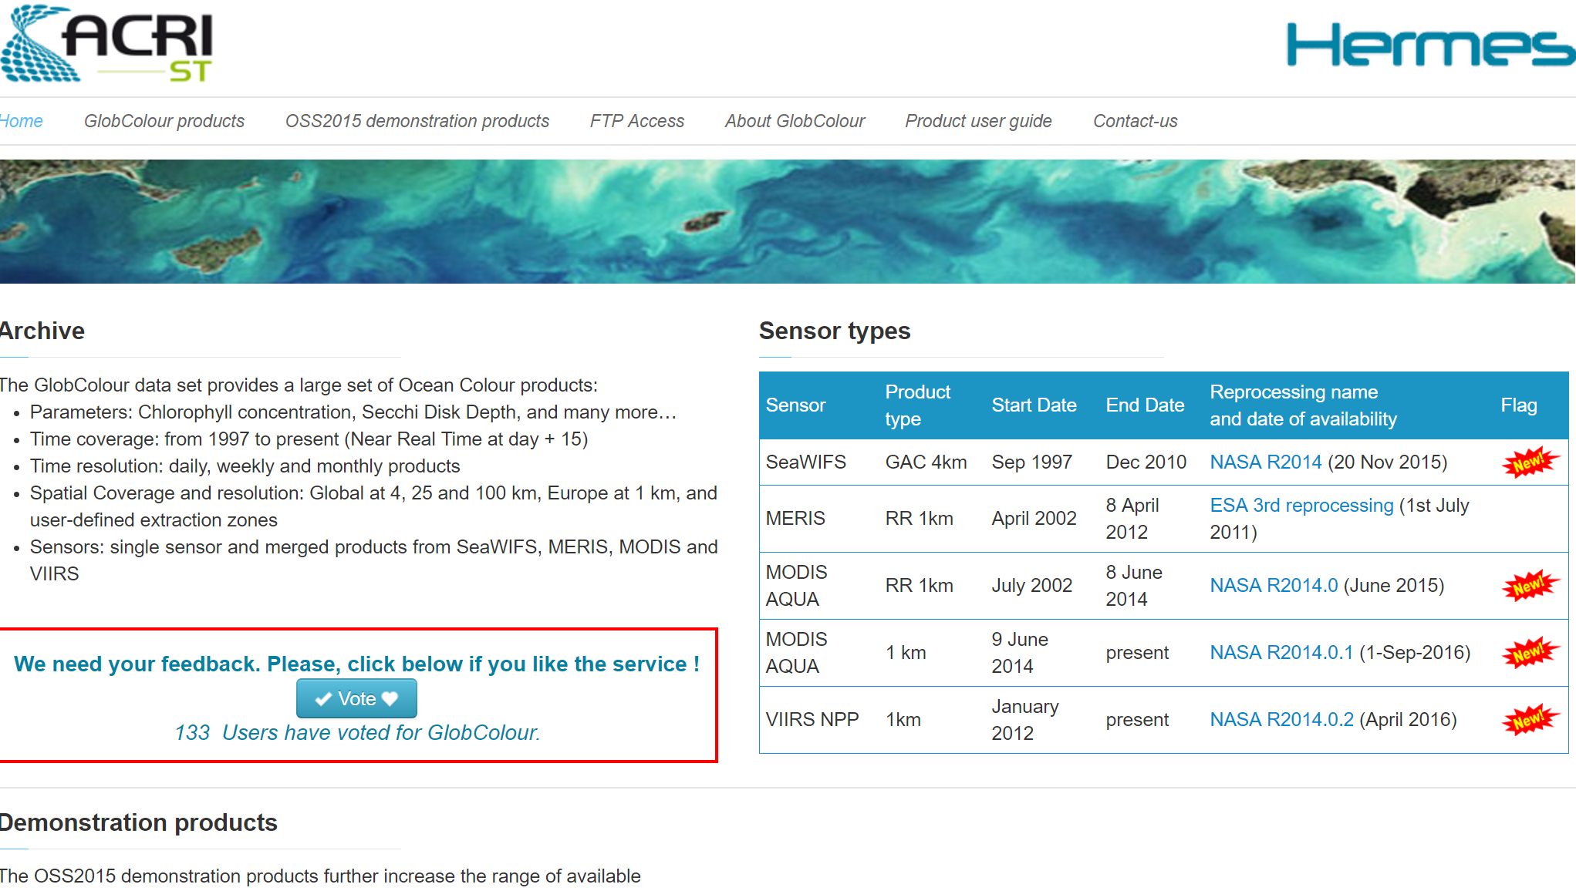
http://hermes.acri.fr/

Slide 6
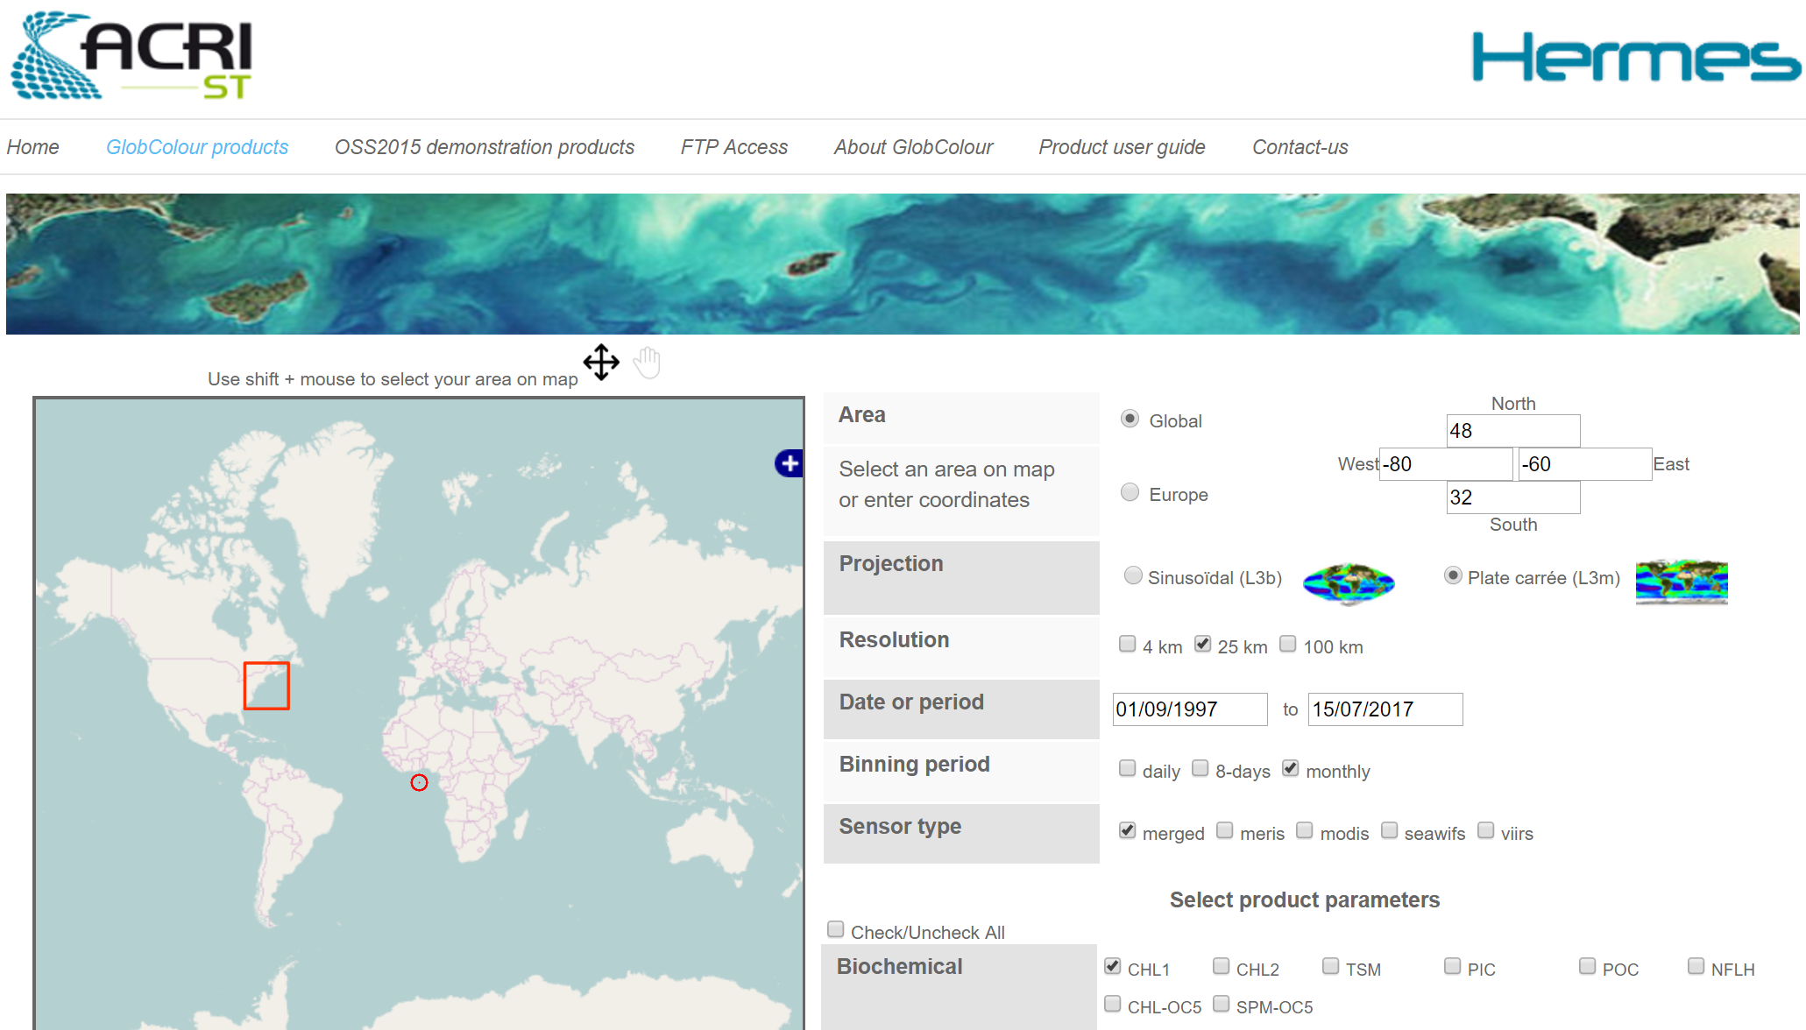
http://hermes.acri.fr/?class=archive

Slide 7
Area: x -80 to -60 y 32 to 48
Projection: Plate
Resolution: 25km (to keep the download manageable)
Date: default 1997 to 2017
Binning: monthly (to keep the download manageable)
Sensor: merged data
Biochemical: CHL1

Slide 8
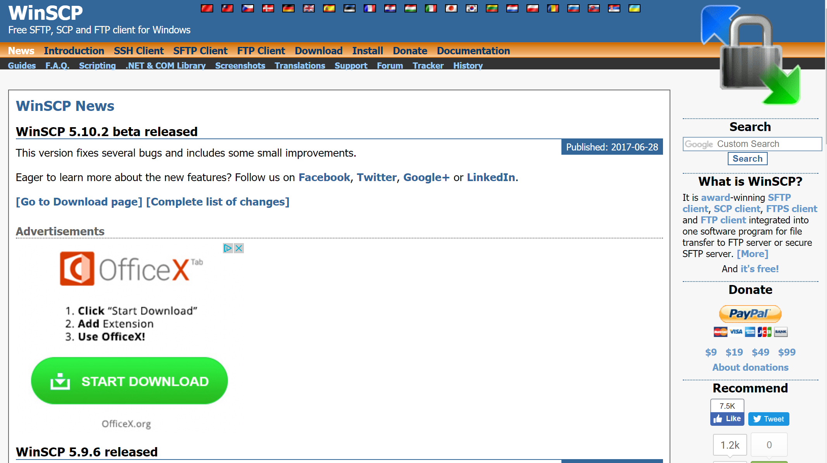
https://winscp.net/eng/index.php

Slide 9
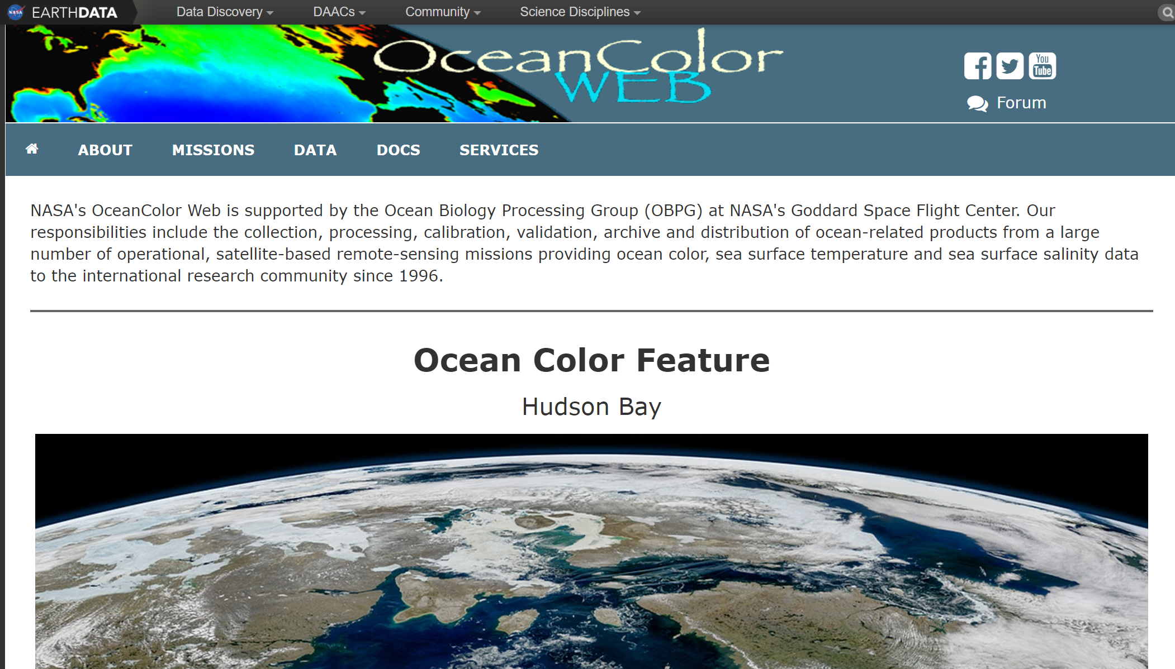
https://oceancolor.gsfc.nasa.gov/

Slide 10
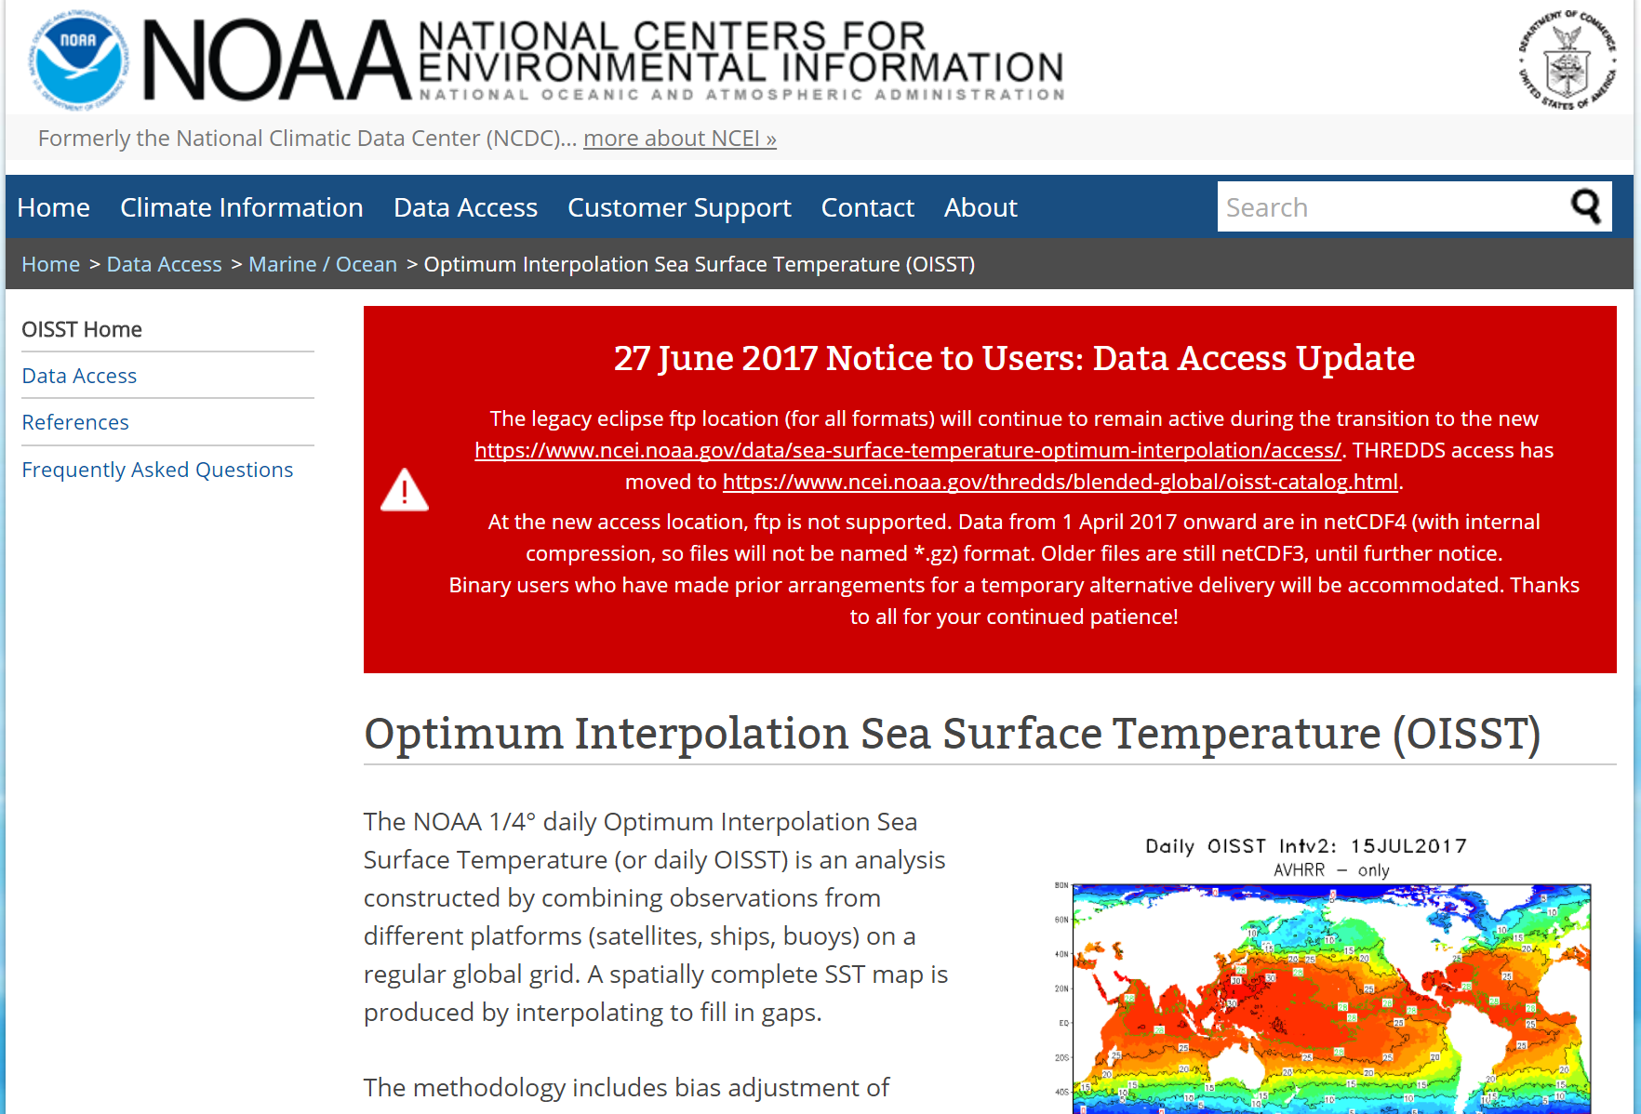
https://www.ncdc.noaa.gov/oisst

Slide 11
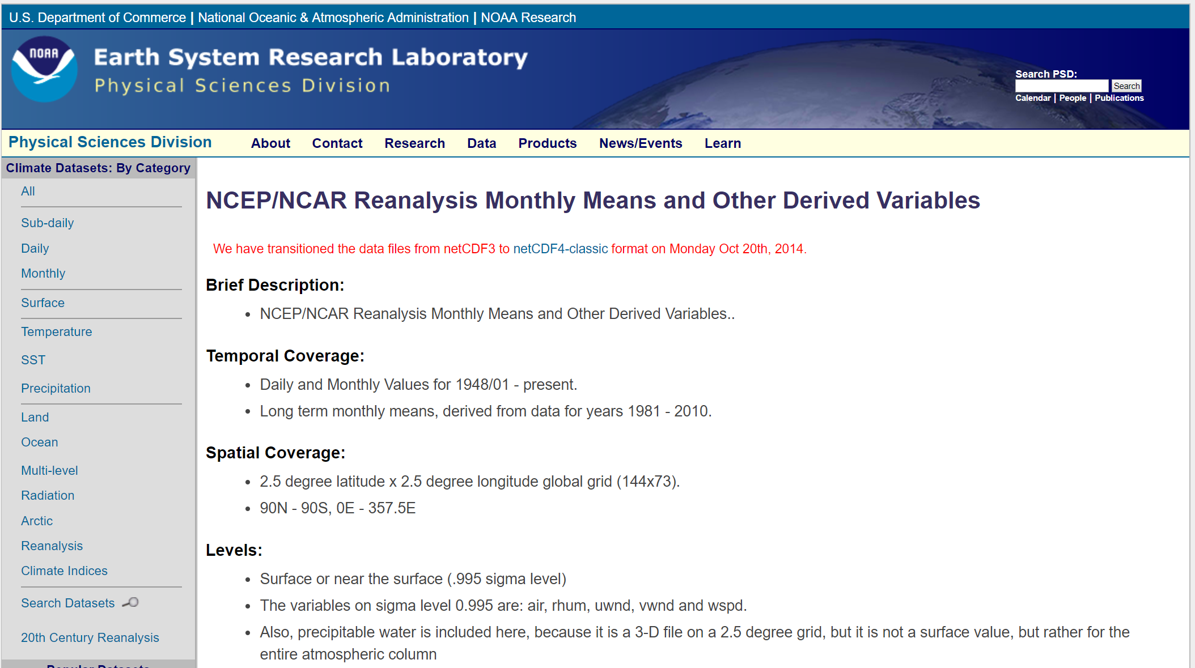
https://www.esrl.noaa.gov/psd/data/gridded/data.ncep.reanalysis.derived.surface.html

Slide 12
A raster is a spatial (geographic) data structure that divides a region into rectangles called ’cells’ (or ’pixels’) that can store one or more values for each of these cells. Such a data structure is also referred to as a ’grid’ and is often contrasted with ’vector’ data that is used to represent points, lines, and polygons.
Introduction to the ’raster’ package, R. J. Hijmans

Slide 13
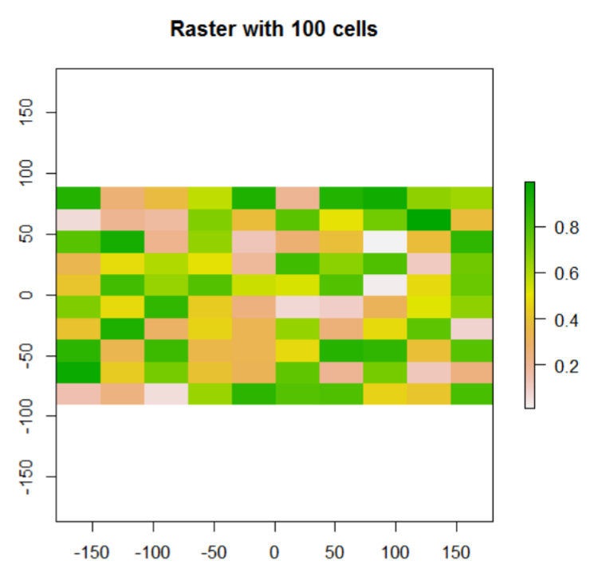

Slide 14
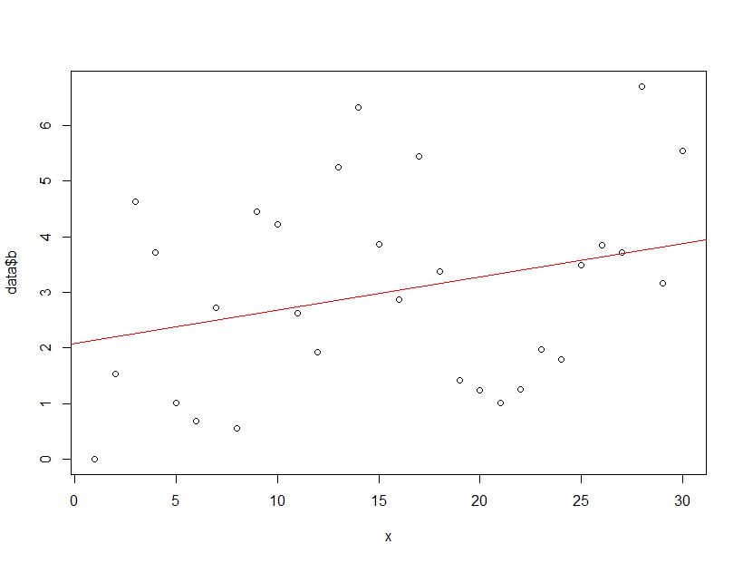
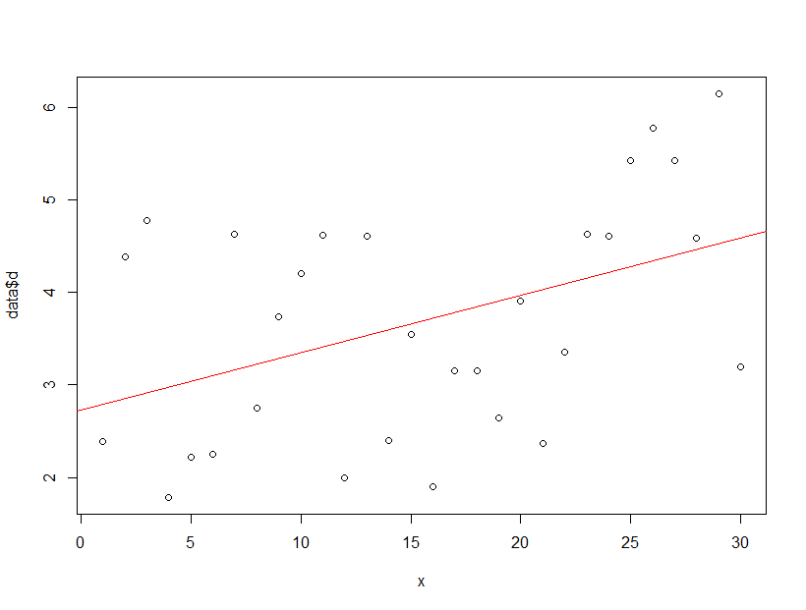
> MannKendall(data$b) tau = 0.191, 2-sided pvalue =0.14348
> MannKendall(data$d) tau = 0.297, 2-sided pvalue =0.022392

Slide 15
Repeat the analysis done for Georges Bank, extract data for a point location of your choosing and for the whole area from the Gulf of Maine (gom), Middle Atlantic Bight (mab), and Scotian Shelf (scs) regions. Contrast the four areas.
How might you use these data to analyze the recruitment of a fisheries species?
Can these data be related to the growth and reproduction of a fisheries species?
What are some strengths and weaknesses of remote sensing data?

